Slide 1

Using an outcome tree to display outcomes for two events
Task A: Outcome trees for two-stage trials
1) This spinner will be spun once.
Complete the outcome tree for this single-stage trial.
2) Spinners 1 and 2 will be spun once each.
B
A
Z
X
Y
E
A
spinner 1
spinner 2
D
B
A
a) What do the two branches in the box represent?
b) Complete this outcome tree.
C
B
X
C
The two outcomes from spinner 1.
A
Y
D
Z
X
E
B
Y
Z
3) Spinner 3 will be spun twice.
a) Complete the outcome tree.
b) Complete the sample space for this outcome tree.
4) Spinners 4 and 5 are spun once each and have these outcomes:
spinner 4 = {A, B}
spinner 5 = {red, blue}
Complete this outcome tree and sample space.
R
P
Q
spinner 3
P
PP
PQ
PR
QP
QQ
QR
RP
RQ
RR
red
A, red
A, blue
B, red
B, blue
P
Q
A
R
blue
P
red
Q
Q
B
R
blue
P
R
Q
R
sample space

Slide 2
Using an outcome tree to display outcomes for two events
5) Spinners 6 and 7 will be spun once each.
Complete the outcome tree from its sample space.
6) Spinners 8 and 9 will be spun once each.
Fill in the outcomes of each spinner from the outcome tree.
T
U
V
spinner 8
sample space
win
G, win
G, lose
G, draw
H, win
H, lose
H, draw
D
D
E
G
lose
T
spinner 9
draw
D
win
U
H
lose
draw
V
E
Task B: Outcome trees from two events
1) This spinner will be spun once.
a) Complete this outcome tree.
16
1
prime number
11
4
square number
8
6
1, 4, 16
not a prime number
1, 4, 16
prime number
not a square number
11
6, 8, 11
not a prime number
6, 8
b) The spinner lands on an 11. Using the outcome tree, which two events have just happened?
A number that isn’t square, but is prime.

Slide 3
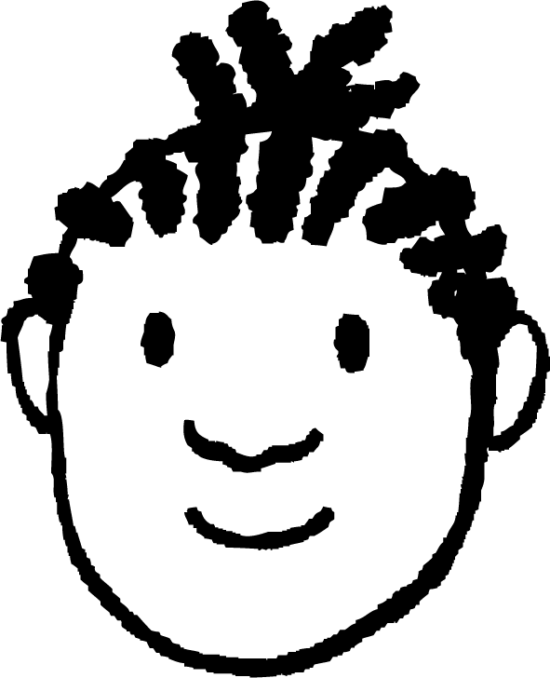

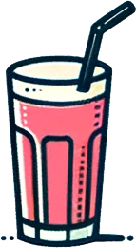
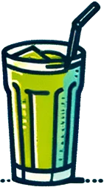



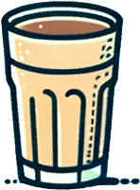


Using an outcome tree to display outcomes for two events
2) A spinner has outcomes of: {5, 9, 15, 25, 28, 441}
Complete this outcome tree.
square number
multiple of 5
25
5, 15, 25
not a square number
5, 15
square number
not a multiple of 5
9, 441
9, 28, 441
not a square number
28
3) A spinner has outcomes of: {1, 4, 8, 16, 25, 27, 30, 36, 39, 64}.
Jacob is going to spin this spinner and looks for the events of landing on a square number that is also a cube number.
Jacob
a) Draw and complete an outcome tree for this trial.
b) How many outcomes match the events that Jacob is looking out for?
cube number
two outcomes
square number
1, 64
1, 4, 16, 25, 36, 64
not a cube number
4, 16, 25, 36
cube number
not a square number
8, 27
8, 27, 30, 39
not a cube number
4) In a cafe they have the following drinks on the menu.
a) Create an outcome tree with the first event being “has a handle” and the second “has a straw”.
30, 39
A
B
C
D
E
straw
handle
B, C, F, I
F
G
H
I
A, B, C, F, I
not straw
b) On your tree circle the outcomes that represent straw but no handle.
A
straw
no handle
D, E, H
D, E, G, H
not straw
G
Mathematics in Education and Industry
v2.3

